Slide 1
Heart Attack Risk 🩺 Predictive Analysis

Slide 2



Meet our team
Mohammad Abdul Imran​
Venkata Raja VaraPrasad Sanayila
Rachana Chinthanippu​
Data Engineer
ML Engineer
Data Analyst

Slide 3


Agenda
A
Introduction
Problem statement
Symptoms of Heart attack
CRISP Methodology
Tools
Dataset
Machine Learning Algorithms
Summary

Slide 4
Introduction
Heart attack prediction is one of the serious causes of morbidity in the world’s population. The clinical data analysis includes a very crucial disease i.e., cardiovascular. Data Science and machine learning (ML) can be very helpful in the prediction of heart attacks in which different risk factors like high blood pressure, high cholesterol, abnormal pulse rate, diabetes, etc... can be considered.

Slide 5
Problem Statement
Given the clinical parameters about the patients, can we predict whether or not they have heart disease?

Slide 6
Heart disease or cardiovascular disease is one of the biggest reason for death across the globe. As it is a cause of 35% of total death worldwide.so, if somehow we manage to find the risk of someone having a heart disease beforehand then it would be helpful.

Slide 7
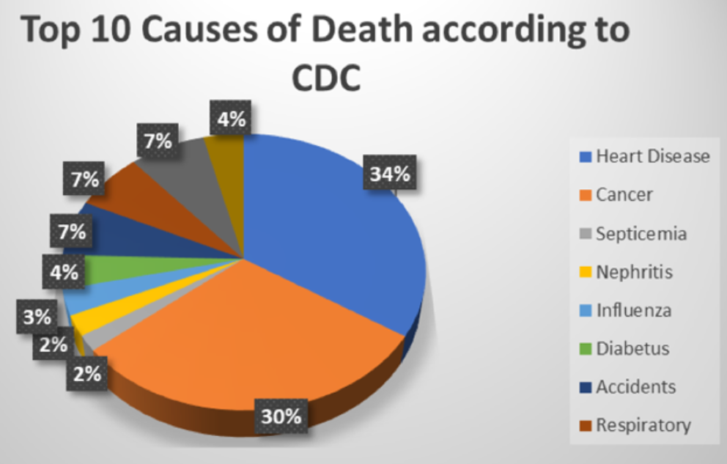
Introduction
Heart attack prediction is one of the serious causes of morbidity in the world’s population. The clinical data analysis includes a very crucial disease i.e., cardiovascular. Data Science and machine learning (ML) can be very helpful in the prediction of heart attacks in which different risk factors like high blood pressure, high cholesterol, abnormal pulse rate, diabetes, etc... can be considered.

Slide 8
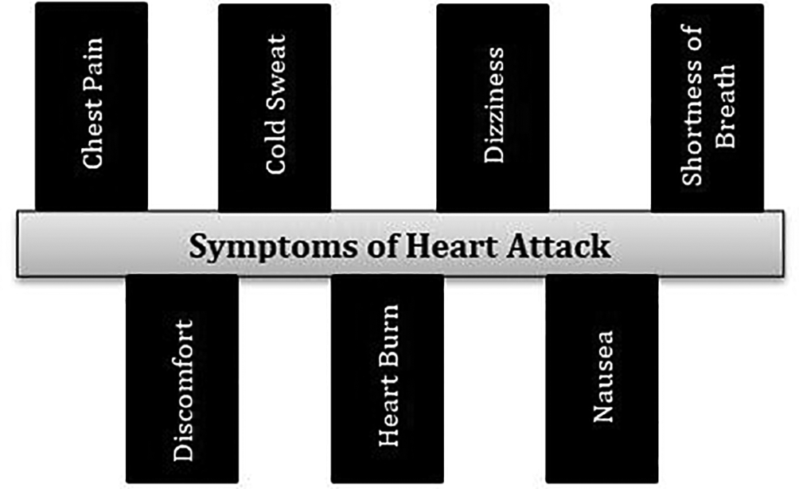
Areas of focus
Symptoms of a Heart attack
F
Cloud-based opportunities
Iterative approaches to corporate strategy
Establish a management framework from the inside

Slide 9
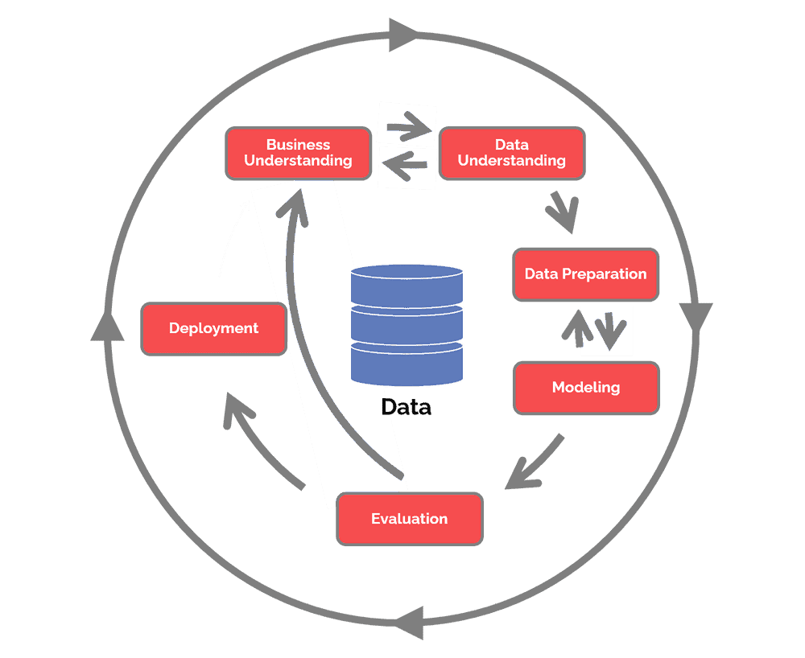
CRISP Methodology

Slide 10
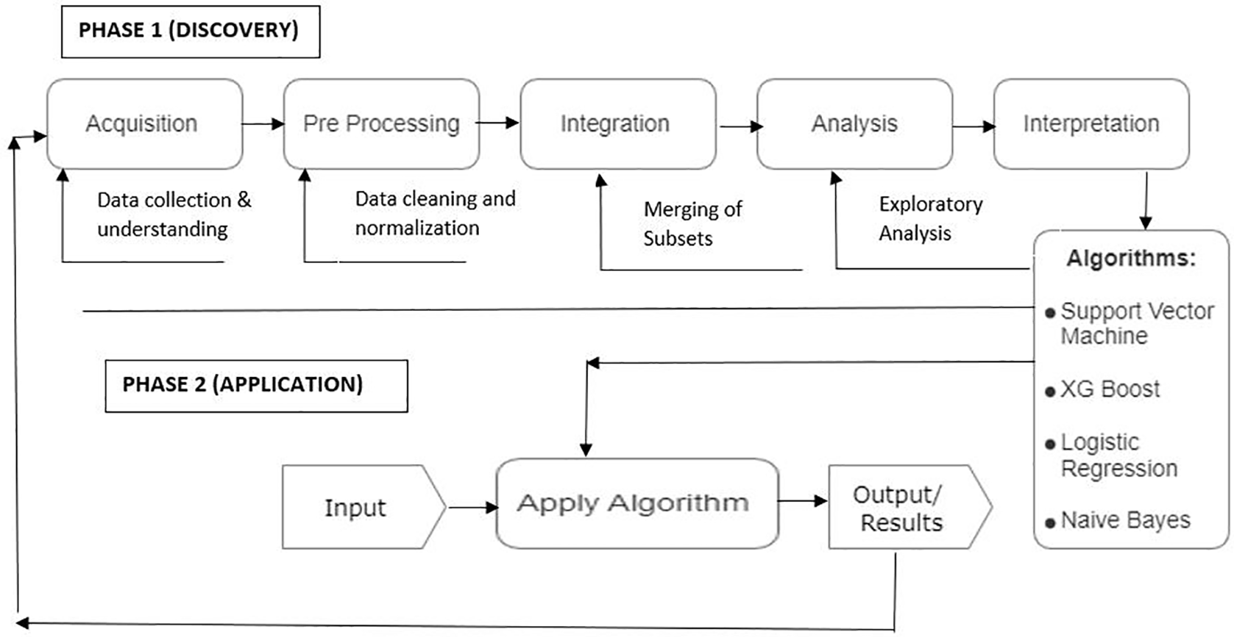
Approach Flowchart
ROI
Niche markets
Supply chains
Envision multimedia-based expertise and cross-media growth strategies
Visualize quality intellectual capital
Engage worldwide methodologies with web-enabled technologies
Pursue scalable customer service through sustainable strategies
Engage top-line web services with cutting-edge deliverables
Cultivate one-to-one customer service with robust ideas
Maximize timely deliverables for real-time schemas

Slide 11
Tools
Gathering Data
Kaggle
Refining Data
Exploratory Data Analysis
Matplotlib
Python
Data Modeling
Python Pandas
Seaborn
Scipy
Scikit
Model Evaluation
Python
Scikit
Deployment
Microsoft Azure
Docker

Slide 12
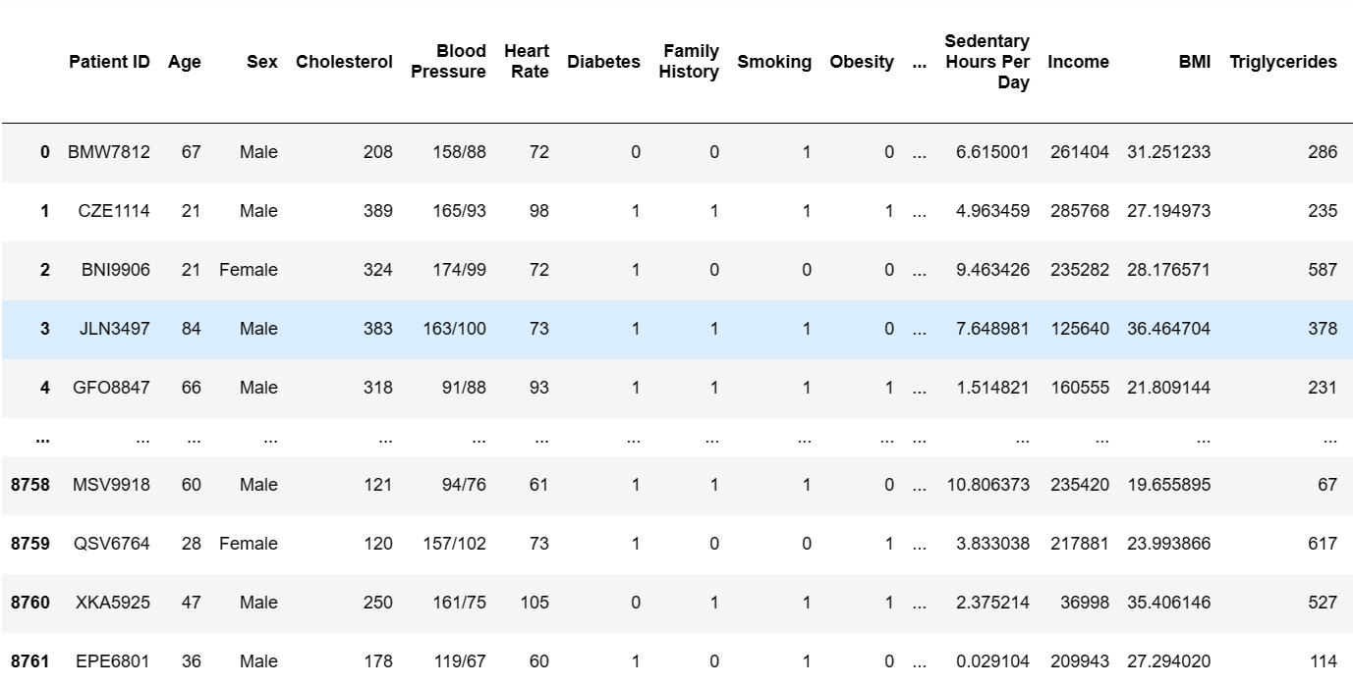
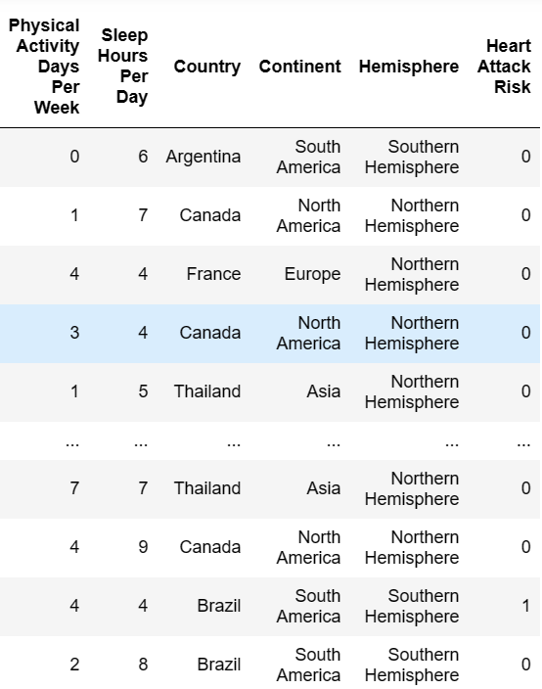
Sample dataset essential attributes for heart disease prediction
Age | Sex | Chest pain (cp) | Resting blood pressure (trtbps) | Cholestoral (chol) | Fasting blood sugar (fbs) | Resting electrocardiographic (restecg) | Maximum heart rate achieved (thalachh) | Exercise induced angina (exng) | Oldpeak | Slope (slp) | Number of major vessels (caa) | Thalium Stress Test (thall) | Output
60 | 1 | 3 | 145 | 233 | 1 | 0 | 150 | 0 | 2.3 | 0 | 0 | 1 | 1
35 | 1 | 2 | 130 | 250 | 0 | 1 | 187 | 0 | 3.5 | 0 | 0 | 2 | 1
41 | 0 | 1 | 130 | 204 | 0 | 0 | 172 | 0 | 1.4 | 2 | 0 | 2 | 1
55 | 1 | 1 | 120 | 236 | 0 | 1 | 178 | 0 | 0.8 | 2 | 0 | 2 | 1
56 | 0 | 0 | 120 | 354 | 0 | 1 | 163 | 1 | 0.6 | 2 | 0 | 2 | 1
55 | 1 | 0 | 140 | 192 | 0 | 1 | 148 | 0 | 0.4 | 1 | 0 | 1 | 1
56 | 0 | 1 | 140 | 294 | 0 | 0 | 153 | 0 | 1.3 | 1 | 0 | 2 | 1

Slide 13
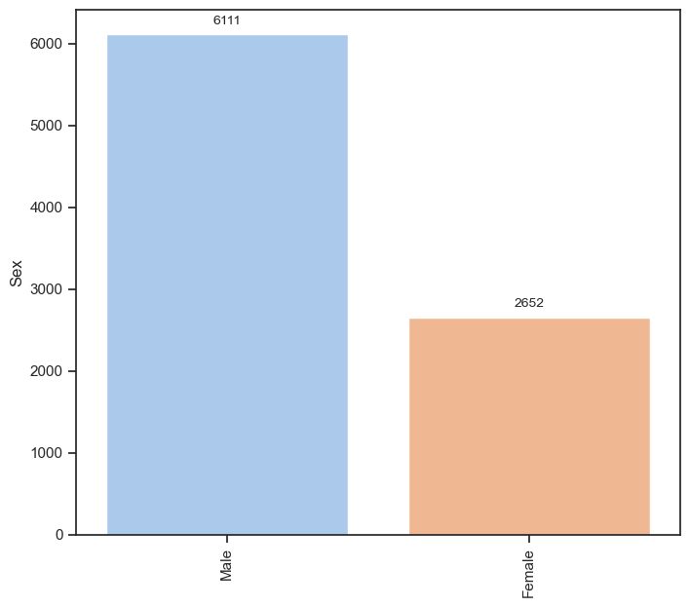
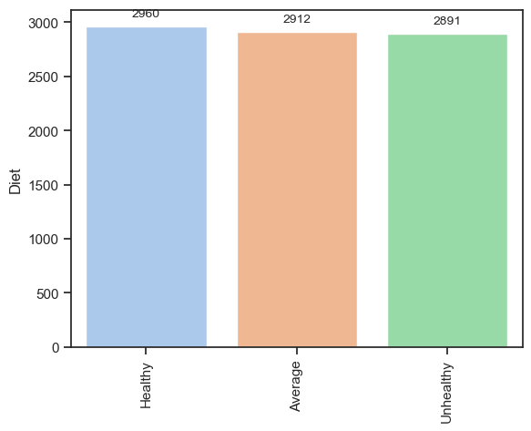
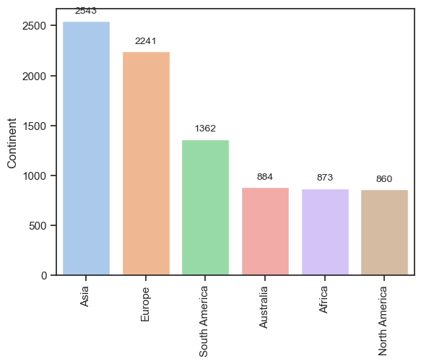
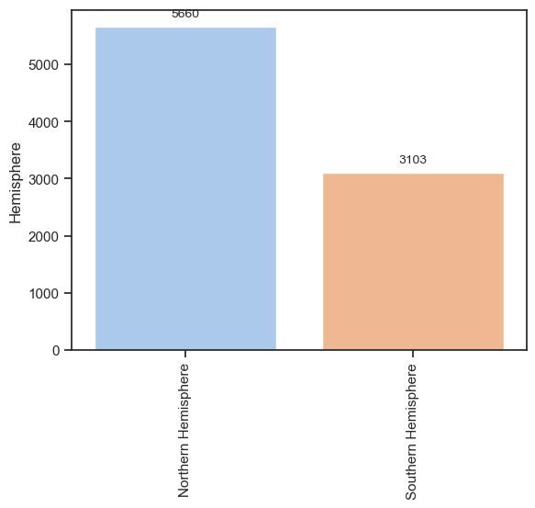
Fig. Bar graphs for comparision over the attributes

Slide 14
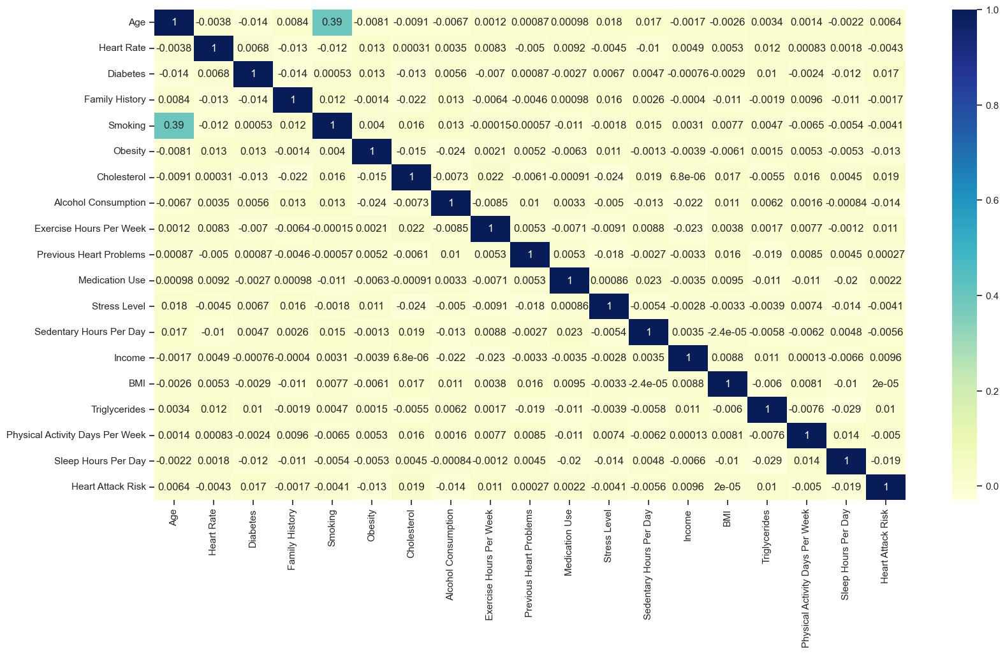
Fig. Linear Correlation between Variables using Heatmap

Slide 15
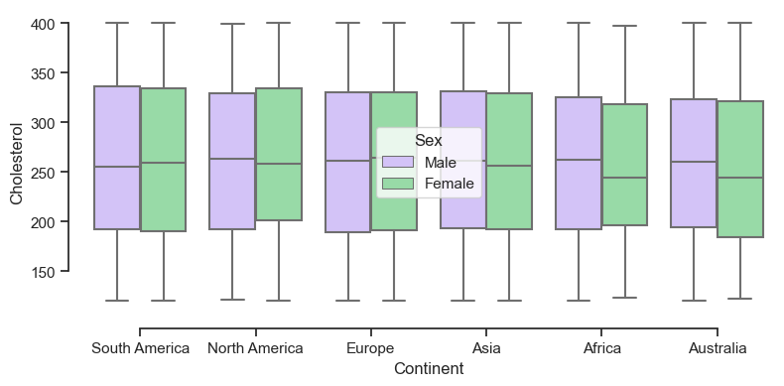
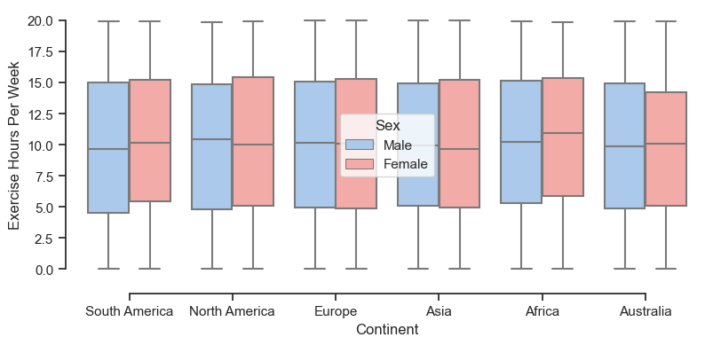
Fig. Heart Attack risk has highest correlation with Diabetes, Cholestrol and Exercise Hours Per Weak

Slide 16
Machine Learning Algorithms
Random Forest Algorithm
The missing values will be handled by the random forest classifier, which will maintain the detection rate of a large portion of the data.•
The Random Forest is made in two stages: the first is to join N choice trees to make the arbitrary timberland, and the second is to make any expectations for each tree created in the principal stage.

Slide 17
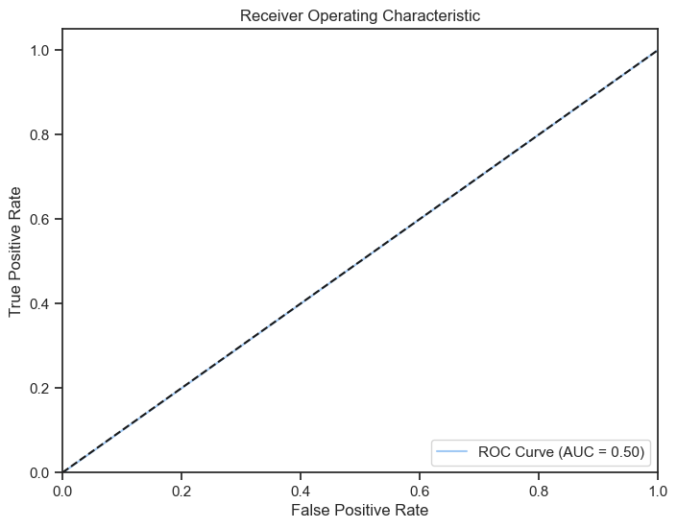

Slide 18
Summary
Using the Machine Learning Algorithm's (Random Forest Analysis).The goal is to study and merge more datasets in order to create a more relevant dataset that encompasses a broad range of population types. The feature selection can be used to generate more relevant features and effective results for the prediction of heart disease.

Slide 19

Thank you

